Slide 1
List / List Variations
By: Prabdeep Gill

Slide 2
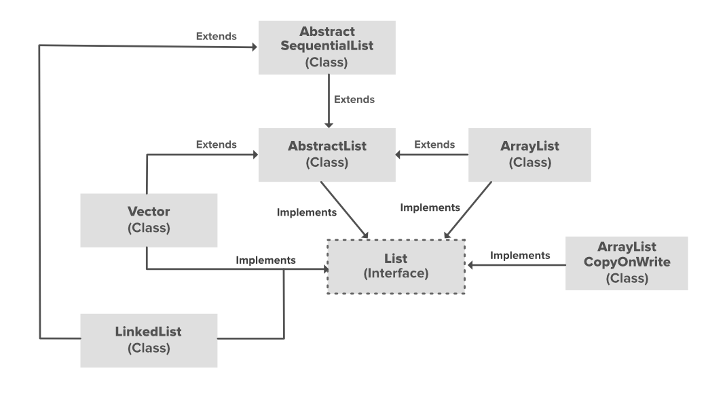
List
Single or mixed data type
You can add, delete, loop over a list
ArrayList

Slide 3
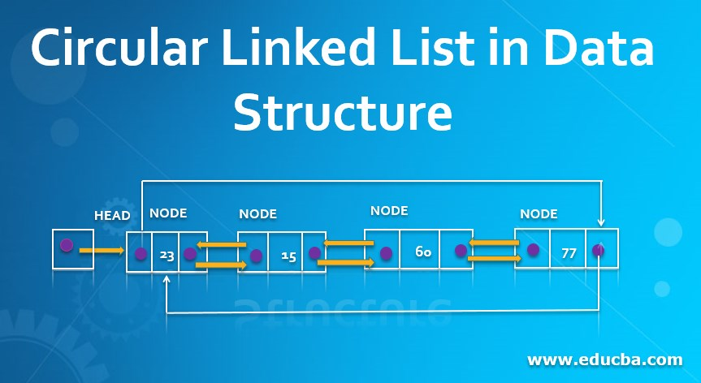
Linked List
A data structure used to store collection of data
Linear
Double
Circular – performed on a single circular list
Multi linked

Slide 4
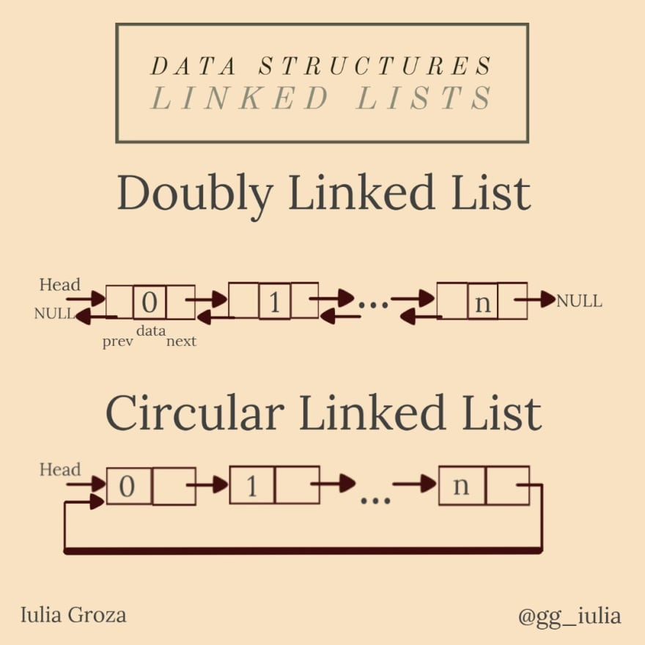
Advantages / Disadvantages Linked List
Disadvantages:
The memory use
Traversing
Advantages:
Dynamic Data Structure
No memory being wasted
Use case
Ability to modify (insert / delete)

Slide 5
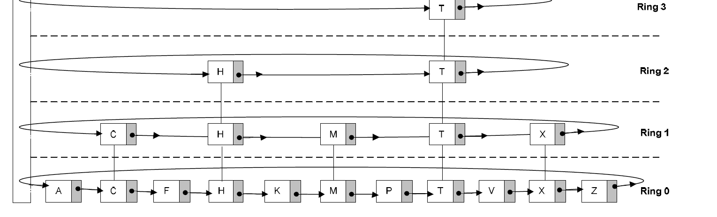
Skip Ring (Circular Skip List) - New Research
By using the circular linked list and skip list data structures, a new data structure called skip ring (circular skip list) was developed.
Operations are performed only on a single ordered list in circular linked list, however, in this method, nodes are searched, inserted and deleted on circular linked lists which are linked to each other in levels that are indexes of each other.

Slide 6
Rings – con.
When rings in the skip data structure are created (Ring 0, 1,…. Ring l), levels are created randomly.
For example, we can say that the number of ordered nodes in our skip ring data structure is N. Ring 0 consists of these entire N ordered nodes.

Slide 7
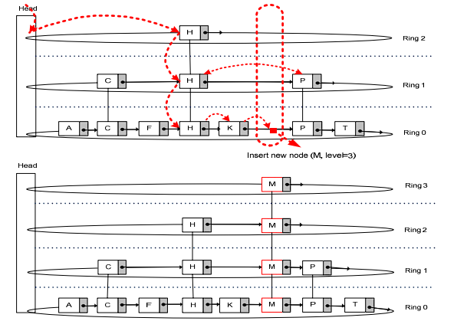
Properties of Skip Ring Data Structure
Skip ring data structure is created through circular linked list and skip list data structures. (similar to binary tree)
It is aimed to focus on the properties of this data structure as a mathematical model and its functions during processes performed in this data structure

Slide 8

Node Insertion
It is required to find the position in order to insert a new node, which requires searching.
It is possible to reach a node in time complexity of O(lg N) at max.
Random level algorithm creates a level between 0,….MaxLevel to form up levels to insert nodes

Slide 9
Applications, what can it do, importance
Search
Insert
Delete
New data structures are sometimes required due to the limitations such as processing time and hardware or inefficiency of current data structures.
Linear Algebra (Portfolio Theory, data consolidation, etc)

Slide 10
Data Consolidation & Memory Management
High frequency trading firms (quant funds)
Helps save a lot of time when breaking down larger data sets
Arbritage Trading

Slide 11
References
Research Paper: Skip Ring/Circular Skip List: Circular Linked List Based New Data Structure
Research Paper: Synchronization risk and delayed arbitrage

